Slide 1
Finance and Risk Analytics A Case study on Investor’s Portfolio

Slide 2
Objectives
Assess the financial goals and risk tolerance of two investors to develop personalized investment strategies aligned with their individual requirements.
Analyze the current portfolio of stocks to identify opportunities for optimizing returns while managing risks according to each investor’s preferences.
Provide tailored investment recommendations by selecting suitable stocks, asset allocations, and strategies to meet the long-term financial objectives of both investors independently.

Slide 3
Problem Scenario
Conservative Investor – Mr. Patrick Jyengar
Initial investment: 500k
Risk : Low
Term: 5 years
Goal: Steady returns
Aggressive Investor – Mr. Peter Jyenger
Initial investment: 1 million
Risk : High
Term: 5 years
Goal: High returns

Slide 4
Data Preparation
Data Exploration
Sector-wise Insights
Key Metrics
Portfolio Analysis

Slide 5
Data Preparation
Data Cleaning:
Missing/Null values were identified and addressed by imputing them with zero.
Converted the 'Date' column to the appropriate Date time format

Slide 6
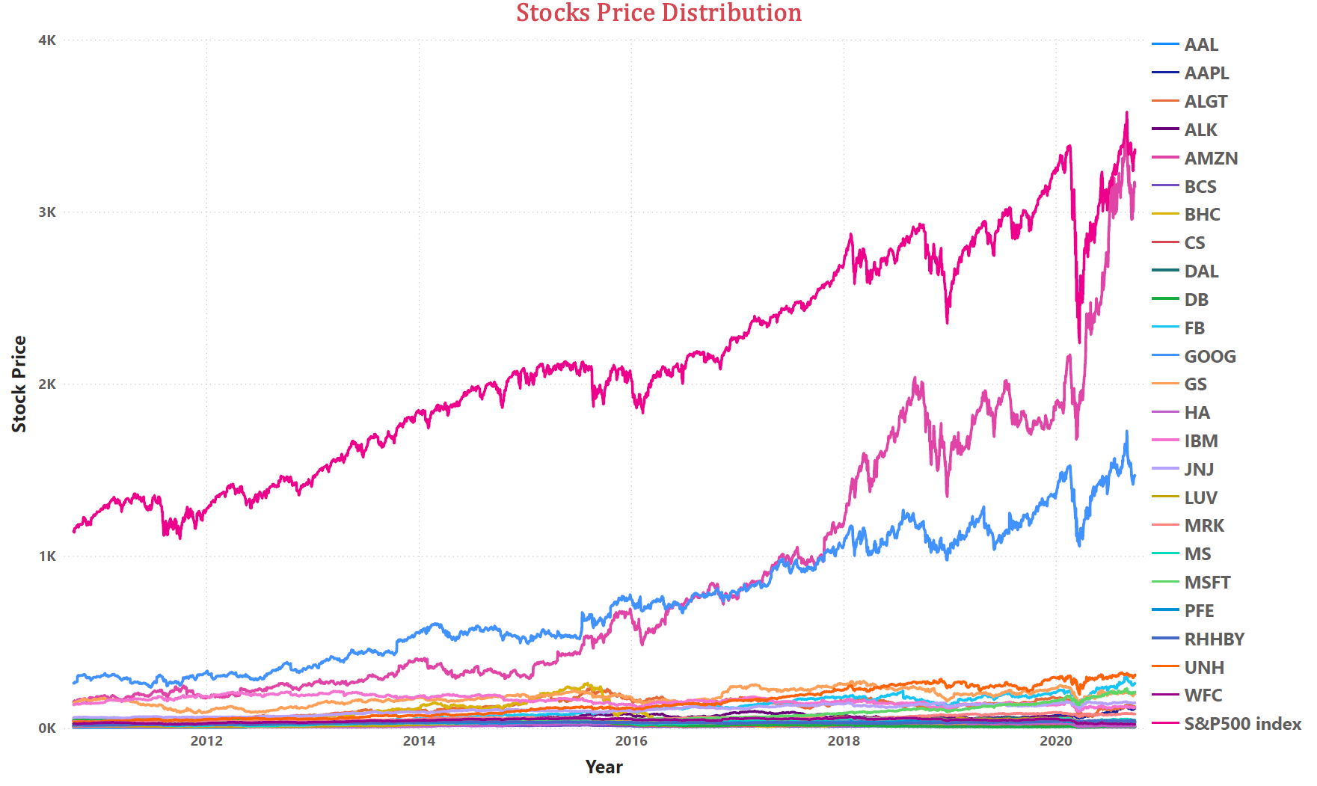
Data Exploration Created a Power BI dashboard for Visualizing the Stock Price distribution of all stocks Stock Analysis.pbix

Slide 7
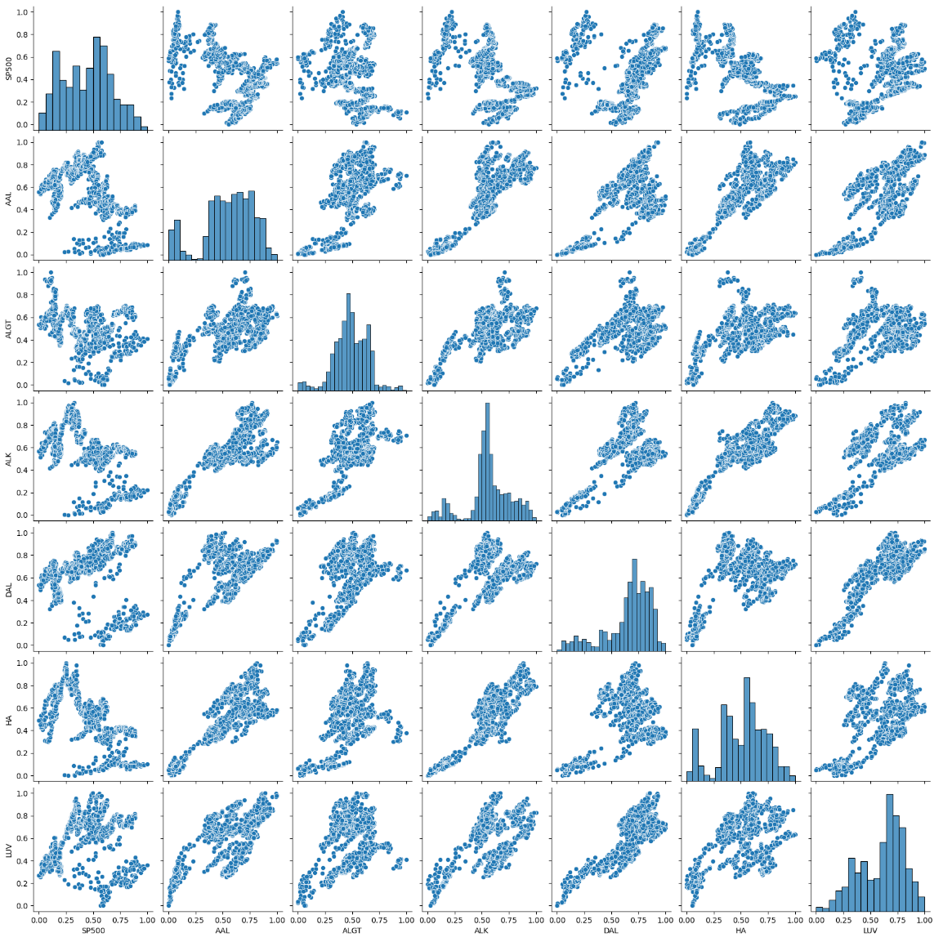
Sector wise Insights
Aviation Sector
S&P500 Market index shows a moderate positive correlation with Airlines stocks as most scatterplot shows upward trend,but not as strongly as the stocks influence each other within the aviation sector.
American Airlines(AAL) shows strong positive correlation with the other Airlines particularly ALGT.
Delta Airlines(DAL) shows a strong correlation with other airlines such as LUV, HA, and ALGT.
The airlines in the plot are highly correlated, reflecting similar responses to market or industry trends.

Slide 8
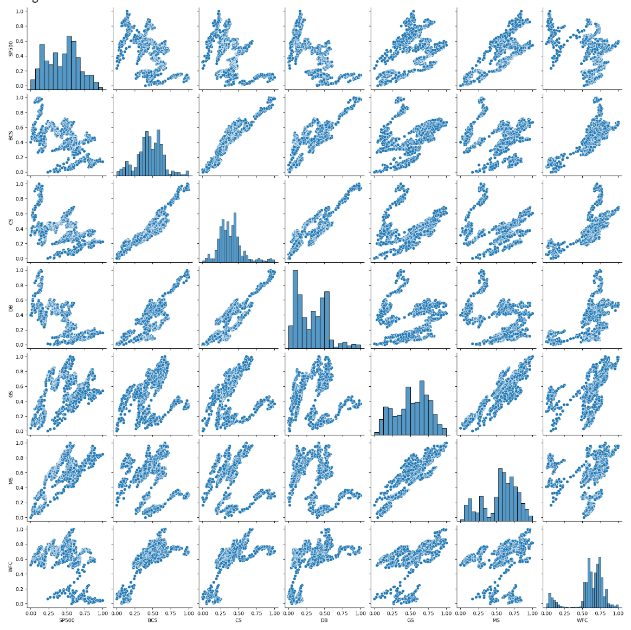
Finance Sector
Strong Correlation: SP500, GS, and MS move closely together, indicating synchronized price movements.
Moderate to Weak Correlation: BCS and DB show scattered relationships, reflecting more independent behaviors.
Distribution: WFC has a focused price range, while SP500 and GS show broader volatility.
In summary: SP500, GS, and MS are correlated, while BCS and DB offer more diversification potential.

Slide 9
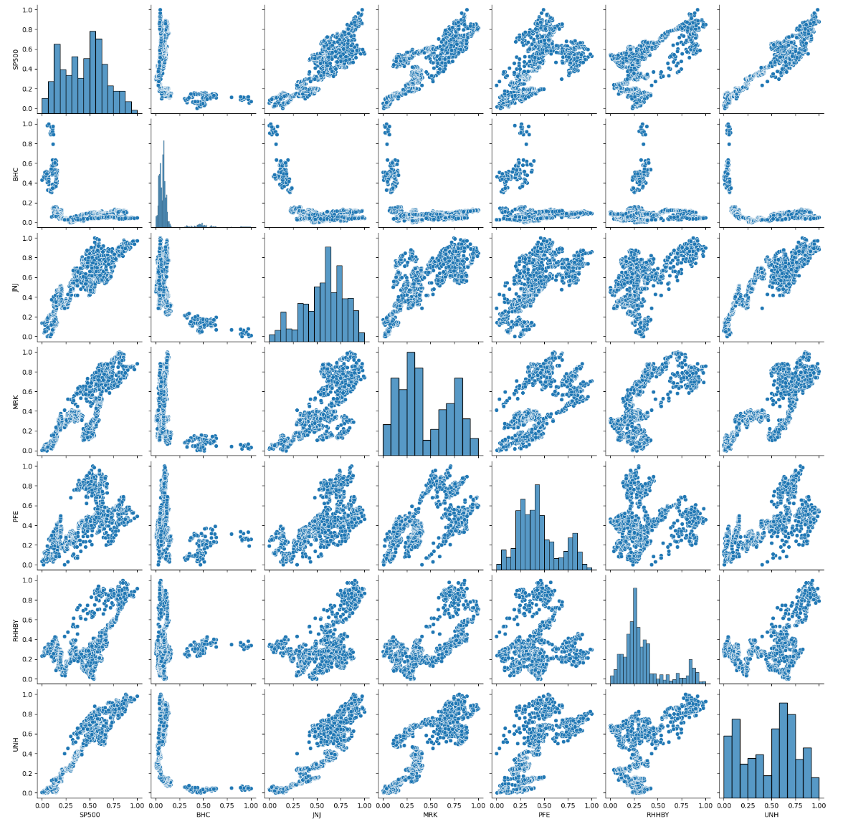
Healthcare Sector
SP500 Correlation: Several stocks strongly correlate with the SP500, aligning their performance with market trends.
Independent Stocks: BHC and RHHBY show weaker correlations, indicating more independent behavior from the broader market.
Clustering vs. Volatility: UNH and PFE exhibit clustering, signaling stability, while others display wider spreads, suggesting higher volatility.
Diversification Potential: The varying stock relationships highlight opportunities for portfolio diversification.

Slide 10
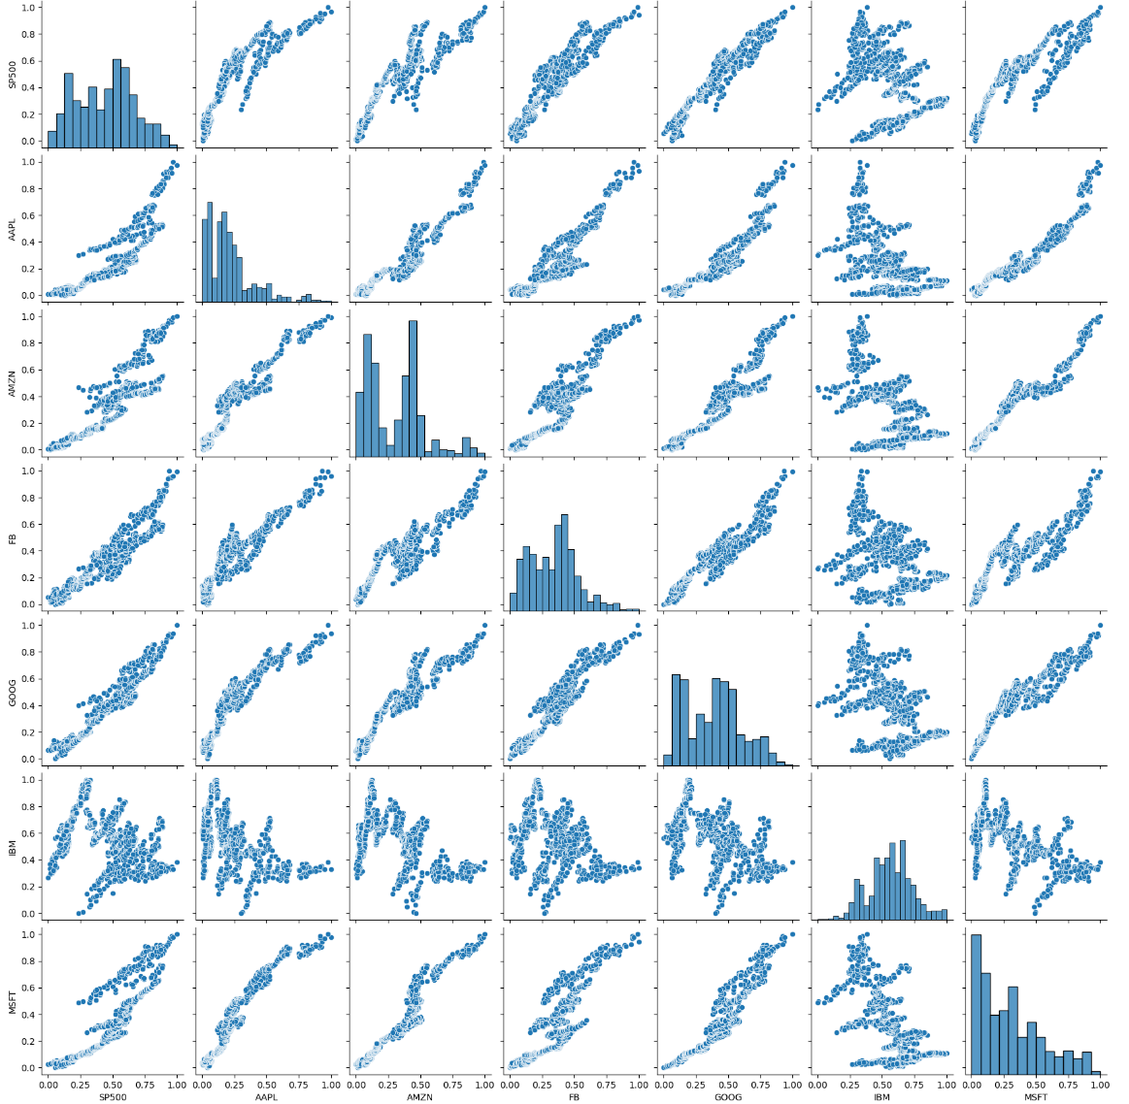
Technology Sector
High Correlation: SP500 & AAPL, SP500 & FB, AAPL & AMZN, and GOOG & MSFT all show strong linear relationships, indicating these stocks tend to move together.
Moderate Correlation: AMZN & FB, AAPL & GOOG, and FB & IBM pairs show moderate clustering, suggesting some level of co-movement but not as strong as the above pairs.
Low Correlation: IBM & MSFT and GOOG & IBM have more scattered points, indicating weaker correlations.

Slide 11
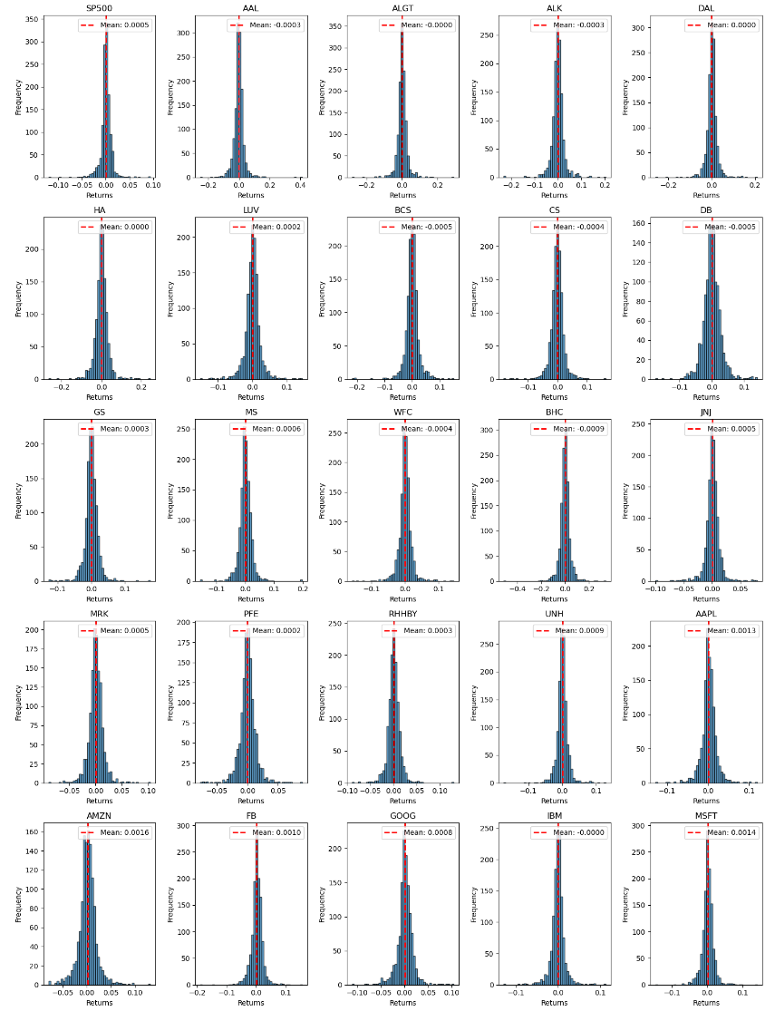
Key Metrics
Stock Price Dispersion from Mean using Histogram Plots
S&P 500 - Small, stable returns with a mean centered around 0.0005 indicating low volatility.
Aviation sector - Negative or near-zero means, suggesting weak performance and low volatility.
Finance sector - Negative and slightly positive mean returns, showing consistent underperformance with limited volatility.
Healthcare sector - Mostly positive means, with consistent performance. JNJ and UNH show stronger stability.
Technology sector - Strong positive mean returns, with tech leaders like AMZN, AAPL, and MSFT standing out with higher performance.

Slide 12
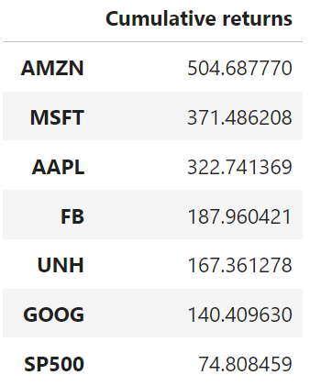
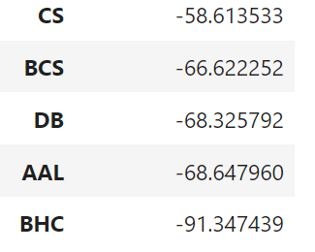
Cumulative Returns
AMZN, MSFT, and AAPL show the highest cumulative returns, indicating strong performance over the period.
BHC, AAL, and DB have the most significant negative returns, reflecting poor performance and substantial losses.

Slide 13
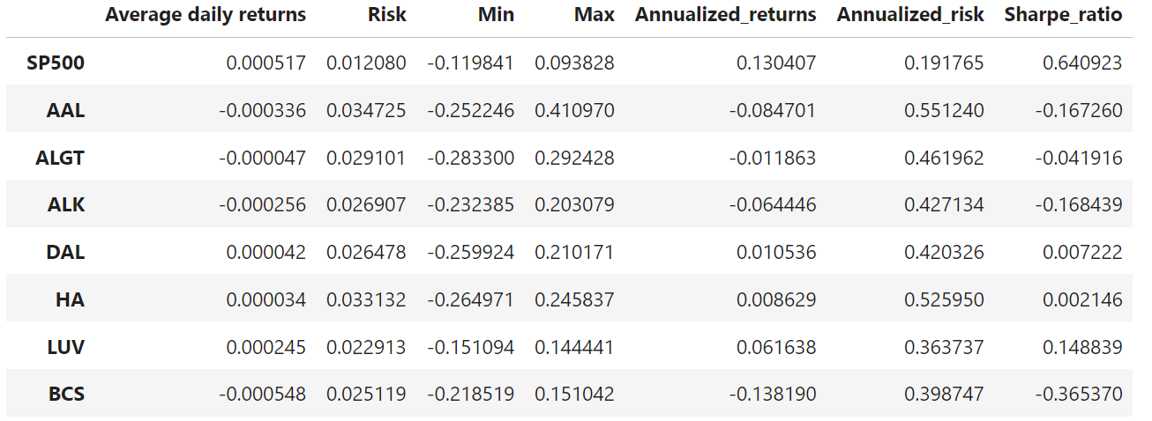
Annualized returns, Annualized risk and Sharpe ratio
Annualized Returns
Positive Values such as AMZN at 40.59% and AAPL at 33.32% indicate expected gains, while BHC at -22.60% suggest potential losses.
Annualized Risk
High values such as BHC at 70.72% and AAL at 55.12% indicate greater uncertainty and risk, while low values like S&P500 index at 13.04% suggest more stable returns, suitable for conservative investors.
Sharpe Ratio
High Sharpe Ratios such as AMZN at 1.32 and AAPL at 1.10 indicate excellent risk-adjusted performance, while low or negative Sharpe Ratios such as BHC at -0.33 and AAL at -0.17 suggest inadequate returns for the risks involved, making the latter less desirable investments.

Slide 14
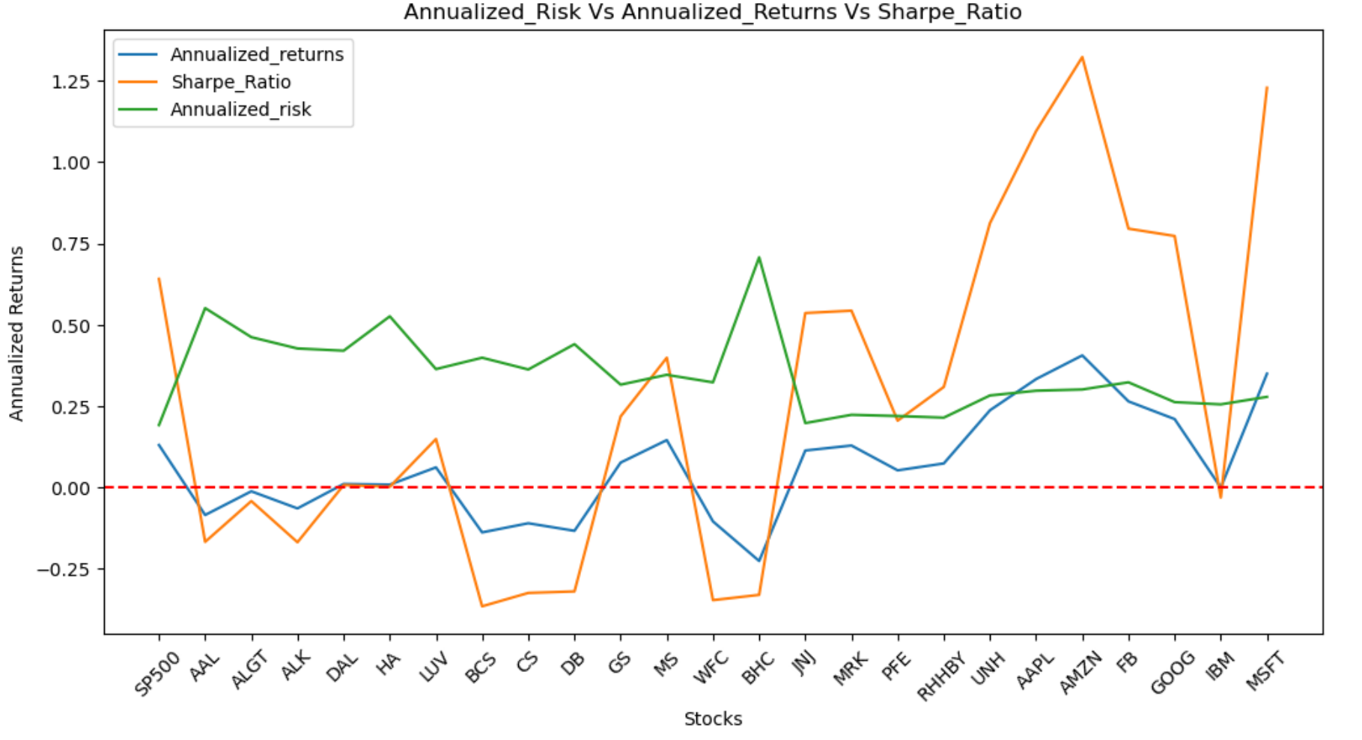

Slide 15
Portfolio Analysis - Recommendations
Conservative Portfolio for Mr. Patrick Jyengar: The portfolio includes stable and lower-risk investments enabling steady growth. Suggested Conservative Portfolio:
JNJ - Annualized Returns: 11.35%, Annualized Risk: 19.78%, Sharpe Ratio: 0.536
MRK - Annualized Returns: 12.88%, Annualized Risk: 22.33%, Sharpe Ratio: 0.543
PFE - Annualized Returns: 5.25%, Annualized Risk: 21.95%, Sharpe Ratio: 0.205
RHHBY- Annualized Returns: 7.38%, Annualized Risk: 21.45%, Sharpe Ratio: 0.309
Aggressive Portfolio for Mr. Peter Jyengar: The portfolio is filled with high-performing tech giants focusing on maximizing returns even with higher associated risks. Suggested Aggressive Portfolio:
AMZN - Annualized Returns: 40.59%, Annualized Risk: 30.11%, Sharpe Ratio: 1.323
AAPL - Annualized Returns: 33.32%, Annualized Risk: 29.73%, Sharpe Ratio: 1.095
MSFT - Annualized Returns: 34.95%, Annualized Risk: 27.84%, Sharpe Ratio: 1.228
FB - Annualized Returns: 26.45%, Annualized Risk: 32.31%, Sharpe Ratio: 0.795
GOOG - Annualized Returns: 21.02%, Annualized Risk: 26.23%, Sharpe Ratio: 0.773
This approach aligns with each investor's risk tolerance and financial goals over the next 5 years.

Slide 16
Conservative Portfolio - Mr Patrick Jyengar
Average Daily Return (0.0366%): The portfolio earns a modest daily gain, reflecting a conservative strategy that focuses on steady, low-risk growth.
Daily Risk (1.35%): With minimal daily fluctuations, the portfolio is stable, ensuring low volatility, which suits risk-averse investors.
Annualized Return (9.22%): Over a year, the portfolio is expected to yield a 9.22% return, offering solid growth while maintaining a conservative risk profile.
Annualized Risk (21.38%): The annualized risk, though higher due to compounding, remains moderate, balancing potential returns with controlled volatility.
Sharpe Ratio (0.396): A Sharpe ratio of 0.396 indicates reasonable risk-adjusted returns, acceptable for a conservative portfolio but with room for capital growth
Final Value after 5 Years ($777220.93): The portfolio will grow to approximately $777 K in 5 years, achieving significant capital growth.
ROI after 5 Years – 55.44%: The portfolio's 55.44% ROI over 5 years shows steady growth, making it a reliable investment for achieving long-term goals.

Slide 17
Aggressive Portfolio - Mr Peter Jyenger
Average Daily Return (0.1342%): The portfolio achieves a relatively high daily return, indicating strong performance and growth potential.
Daily Risk (1.89%): The portfolio experiences moderate daily fluctuations, but the returns justify the risk, suitable for investors with a slightly higher risk tolerance.
Annualized Return (33.83%): Over the course of a year, the portfolio is expected to yield a substantial 33.83% return, indicating aggressive growth and effective investment choices.
Annualized Risk (29.99%): While the annualized risk is relatively high, the portfolio compensates with proportionately higher returns, balancing risk and reward effectively.
Sharpe Ratio (1.10): A Sharpe ratio of 1.10 indicates excellent risk-adjusted returns, suggesting that the portfolio is highly efficient in generating returns relative to the risk taken.
Final Value after 5 Years (4293224.66)The Portfolio will grow to over $4.29 million, reflecting strong capital appreciation over 5 years.
ROI after 5 Years – 329.32% With an ROI of 329.32%, the portfolio demonstrates consistent growth, making it a solid performer over the investment horizon.

Slide 18
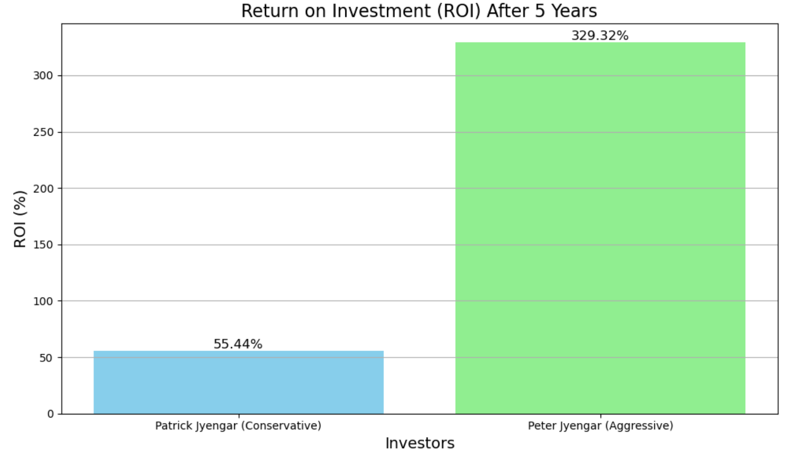
Key Insights:
The aggressive portfolio greatly outperforms the conservative one in terms of final portfolio value and ROI, achieving over 4 times the initial investment with substantial returns. However, it carries much higher risk, which might be unsuitable for risk-averse investors.
The conservative portfolio provided steady, low-risk returns with 55.44% growth over 5 years, which aligns well with the goal of protecting capital while still achieving some growth.

Slide 19
Thank You
By Harshavardhini J S

